Slide 2
Survival Analysis Section

Slide 3
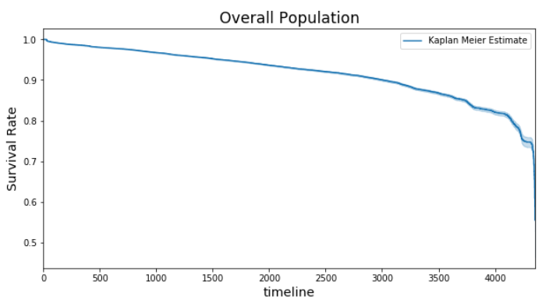
Survival Curve: Overall Population
~82% Survival Rate
@ 4000 Days

Slide 4
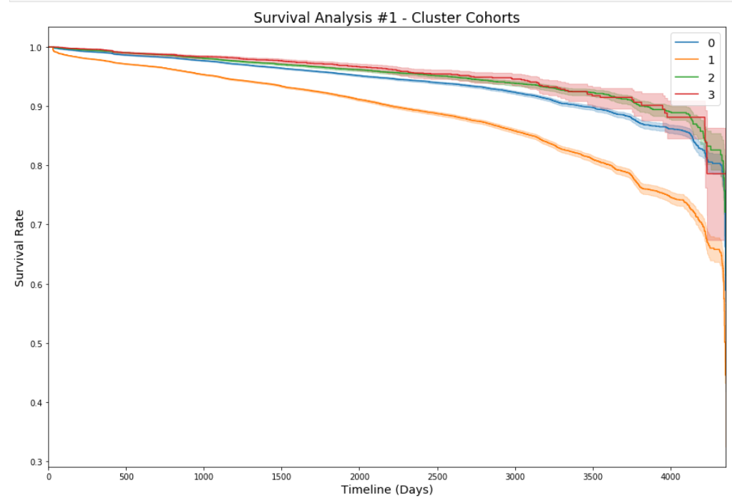
Cluster = 0, 2 & 3
~89% Survival Rate
@ 4000 Days
Cluster = 1
~75% Survival Rate
@ 4000 Days

Slide 5
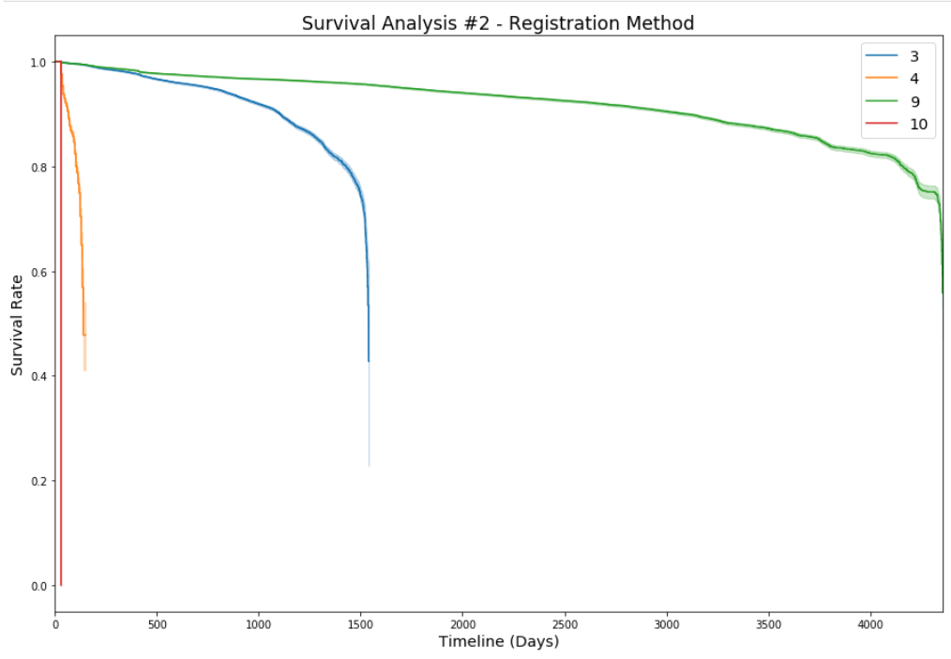
Reg. Method = 3
80% Survival Rate
@ 1400 Days
0% Survival Rate
after 1600 Days
Reg. Method = 9
80% Survival Rate
@ 4000 Days
Reg. Method = 4 & 10
Near, immediate Death

Slide 6
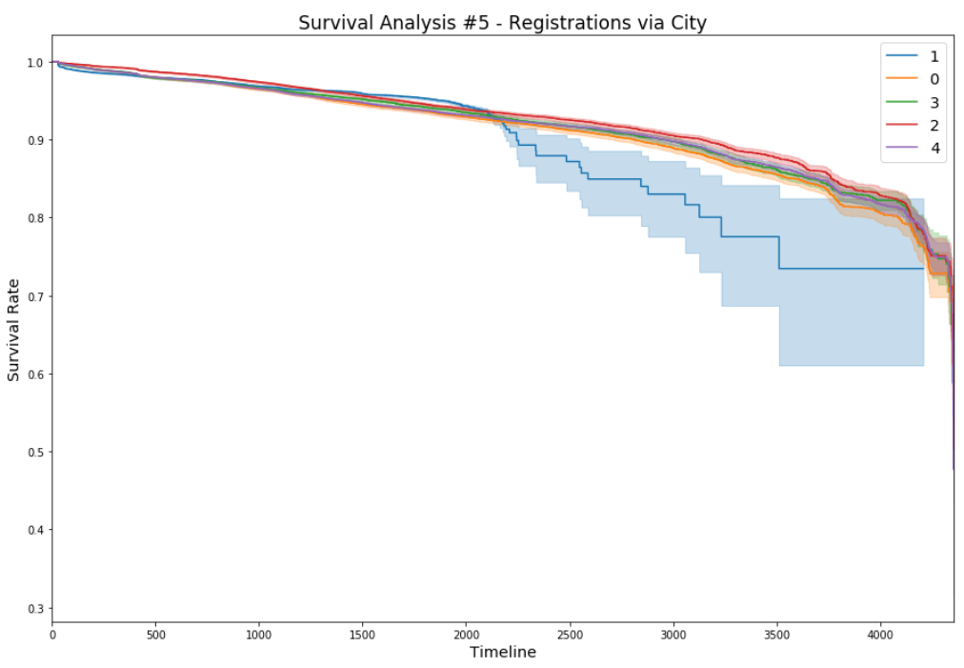
City = 0, 2, 3, and 4
~82% Survival Rate
@ 4000 Days
City = 1
~73% Survival Rate
@ 4000 Days

Slide 7
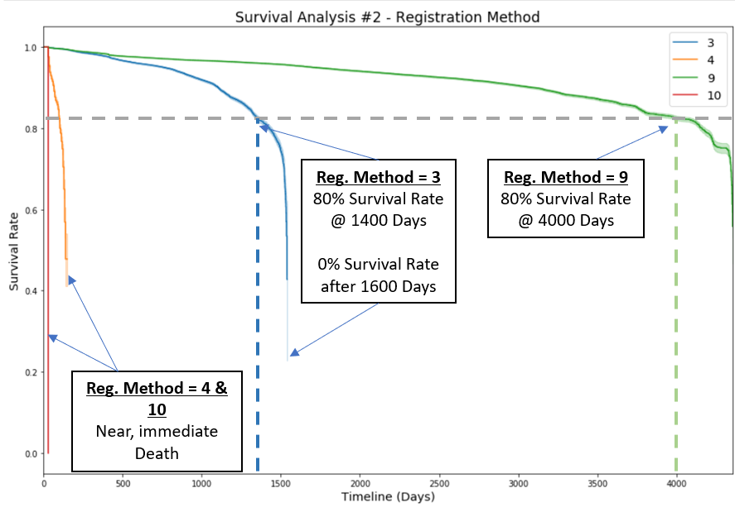
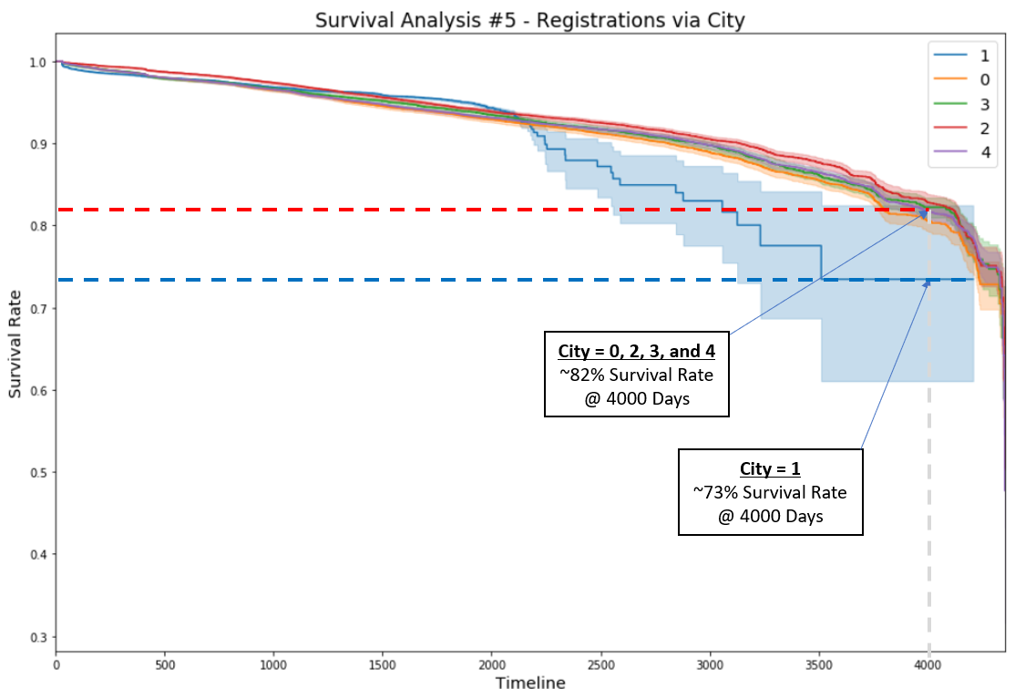

Slide 8
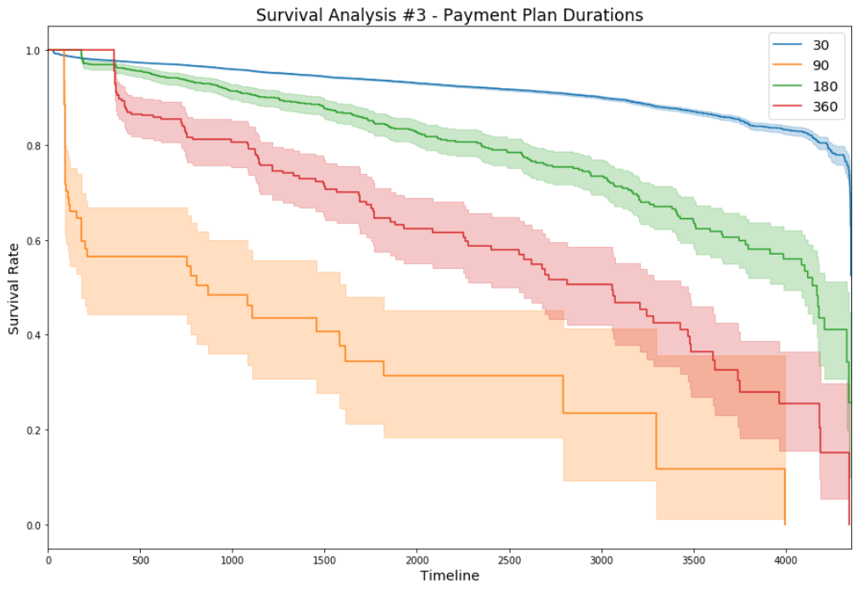

Slide 9
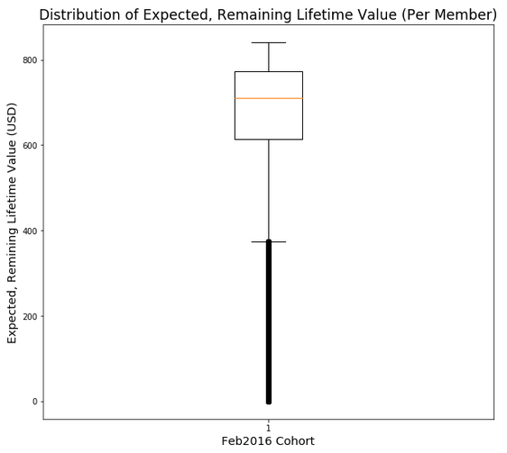
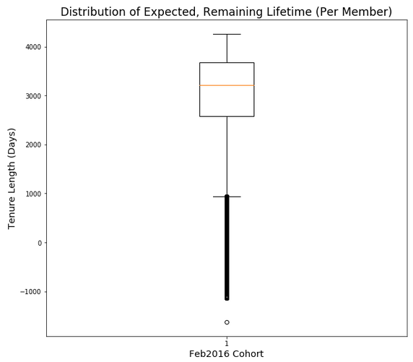
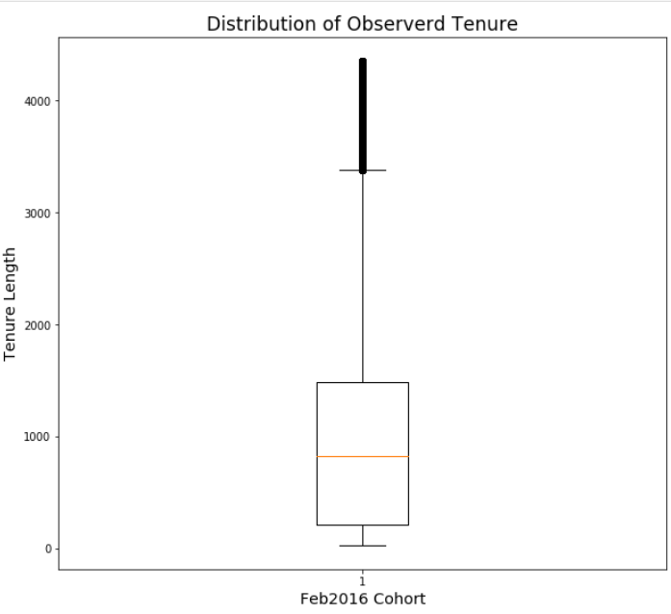
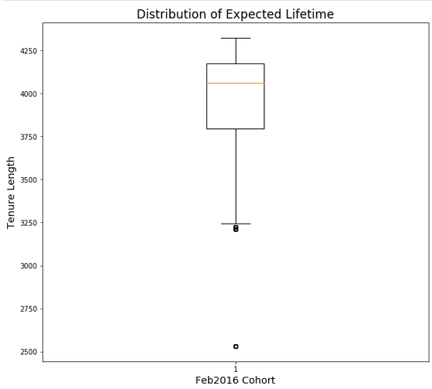

Slide 10
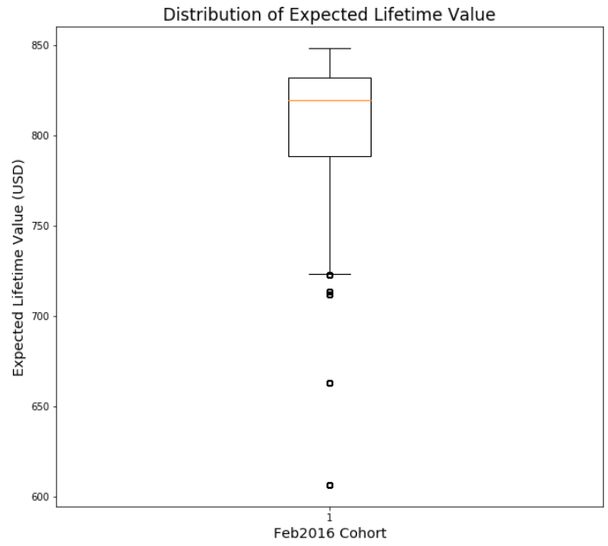
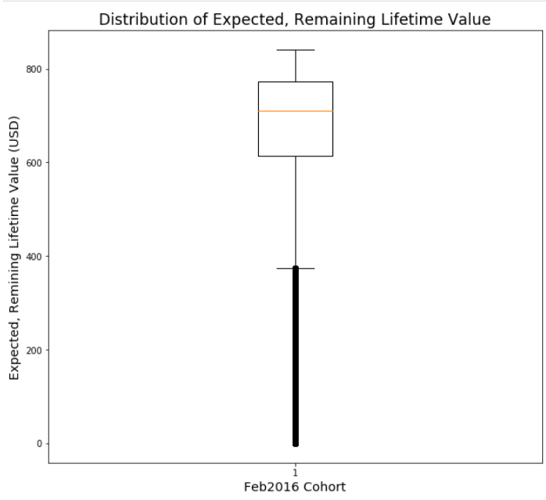

Slide 11
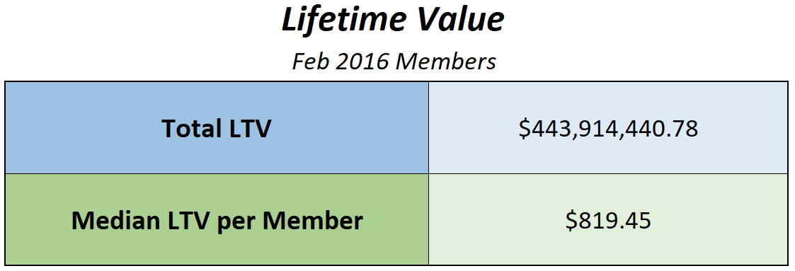
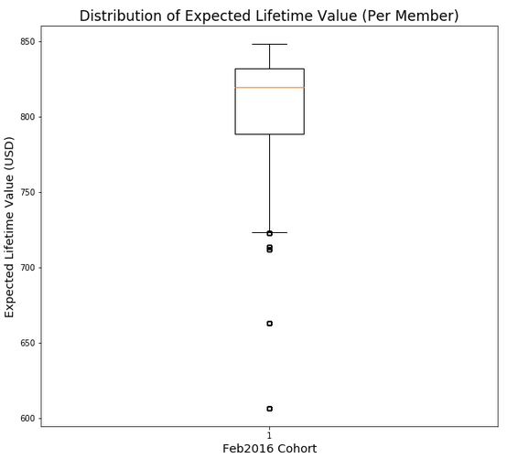

Slide 12
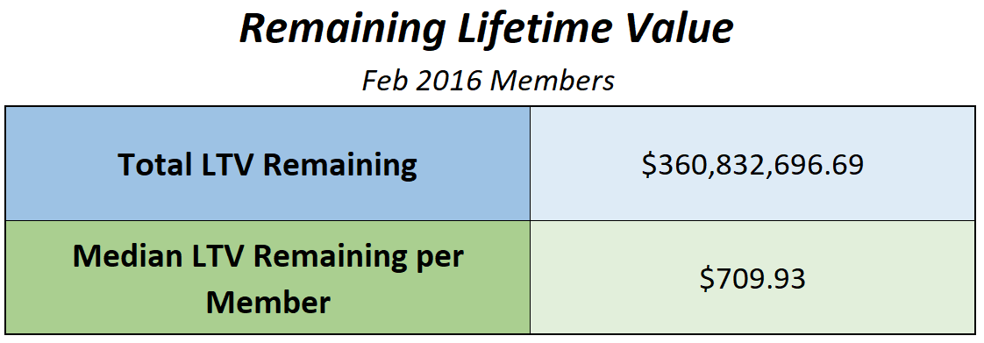


Slide 13


Slide 14
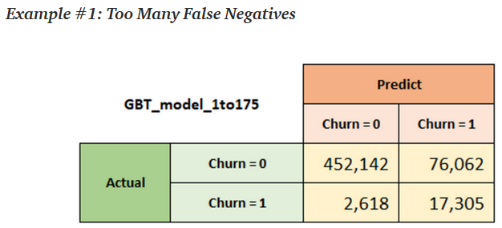
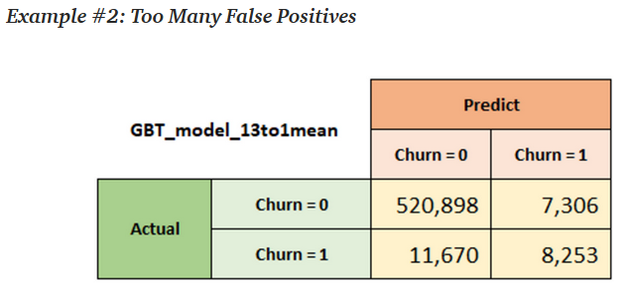
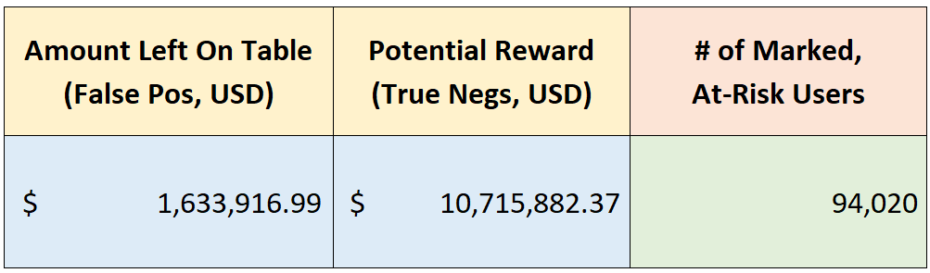
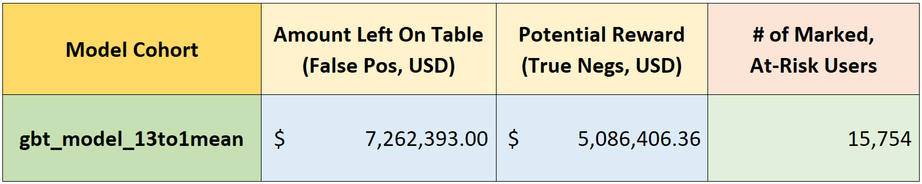
Actually
High-Risk
Actually
High-Risk
Marked as
High-Risk
Marked as
High-Risk

Slide 15
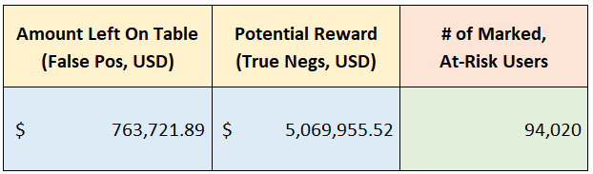
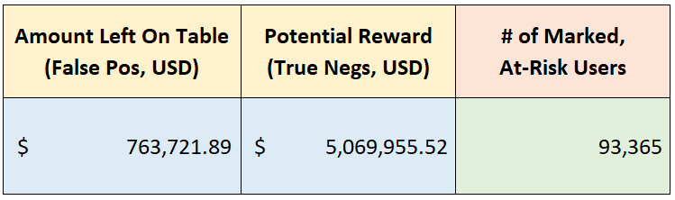
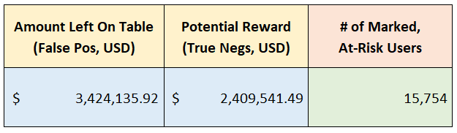
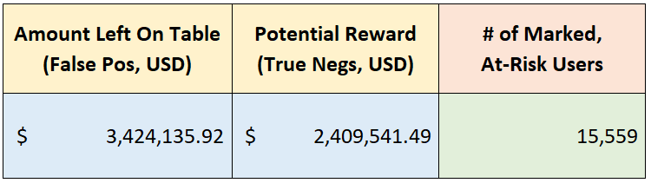
Actually
High-Risk
Marked as
High-Risk
Actually
High-Risk
Marked as
High-Risk

Slide 16
Actually
High-Risk
Marked as
High-Risk

Slide 17
Actually
High-Risk
Marked as
High-Risk

Slide 18
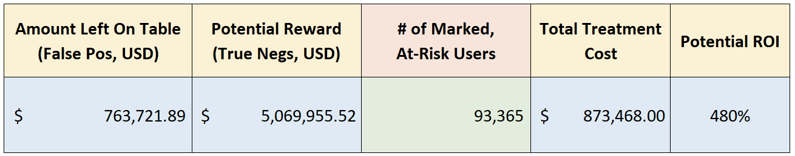
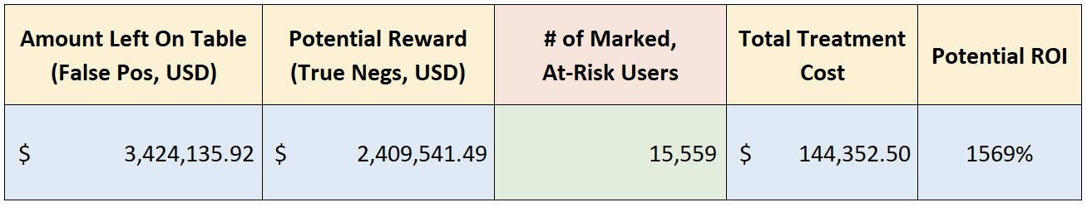
Actually
High-Risk
Marked as
High-Risk
Actually
High-Risk
Marked as
High-Risk

